Slide 1
Dana SAC Benelux Teambrief
11 Jun 2019

Slide 2
APT Offshore Hydr. PowerUnit
2x 75kW 50Hz (87kW 60Hz) electric motors from Hoyer.
1100 liter Oil reservoir (Custom design).
2x S5AV 93cc LS-pumps, housings cooled by a amount of oil flow delivered by a 38cc OT gearpump. Both pumps will deliver approx. 165 l/min at 320 bar at 60Hz.
Both pump controls were set so both the electric motors would not exceed the limit of 130 Amps.
2x HPV77/1 valves, limiting the oil flow to approx. 130 l/min at 300 bar (50Hz test results, next slide)
Oil/Air Cooler, feeded by the 38cc OT gearpump.
Technical problem(s) we had during this project;
Selected S5AV 093 pumps had NLP0X controls (constant power). These controls have a power limitation of 60kW, something we were not aware of. Rebuilding the pumps (fitting the correct controls) solved this problem ☺

Slide 3
APT Offshore Hydr. PowerUnit

Slide 4
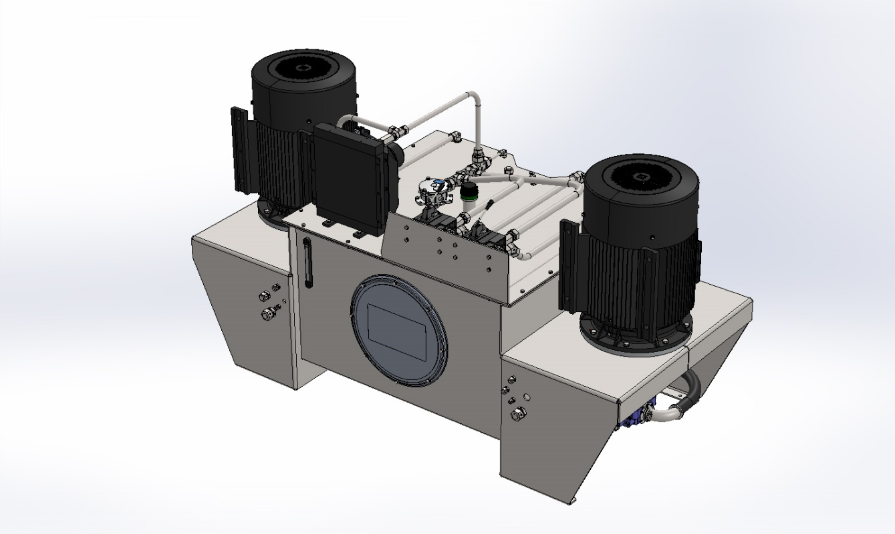
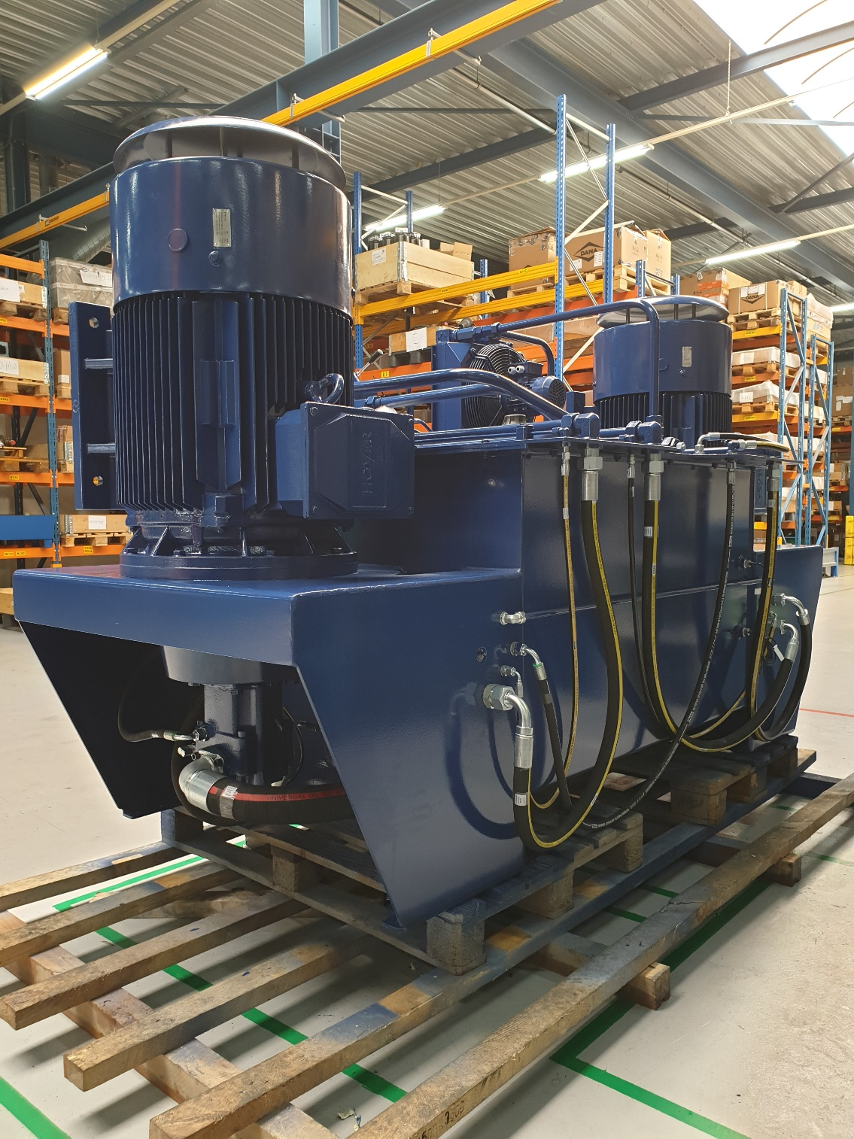
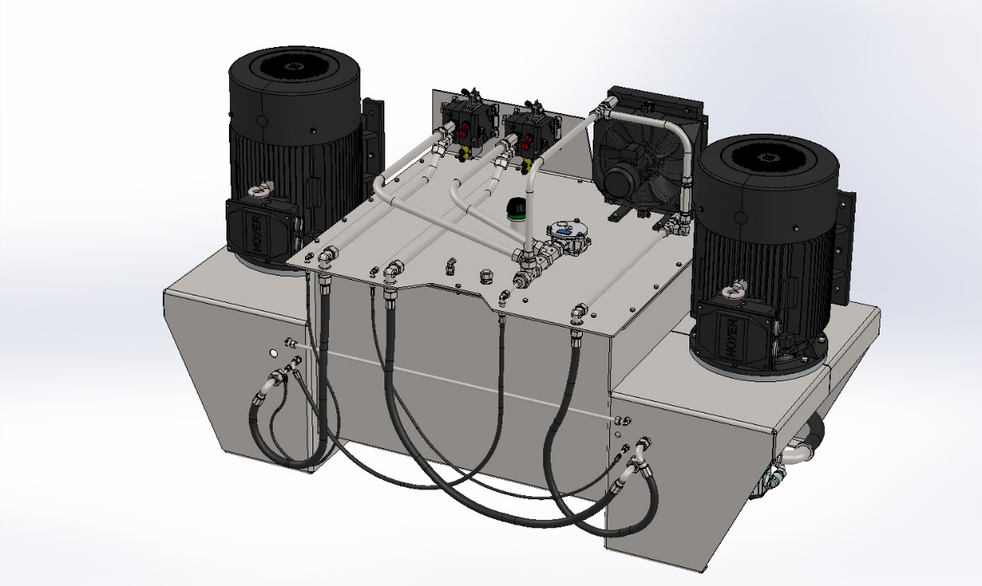
APT Offshore Hydr. PowerUnit

